Slide 1
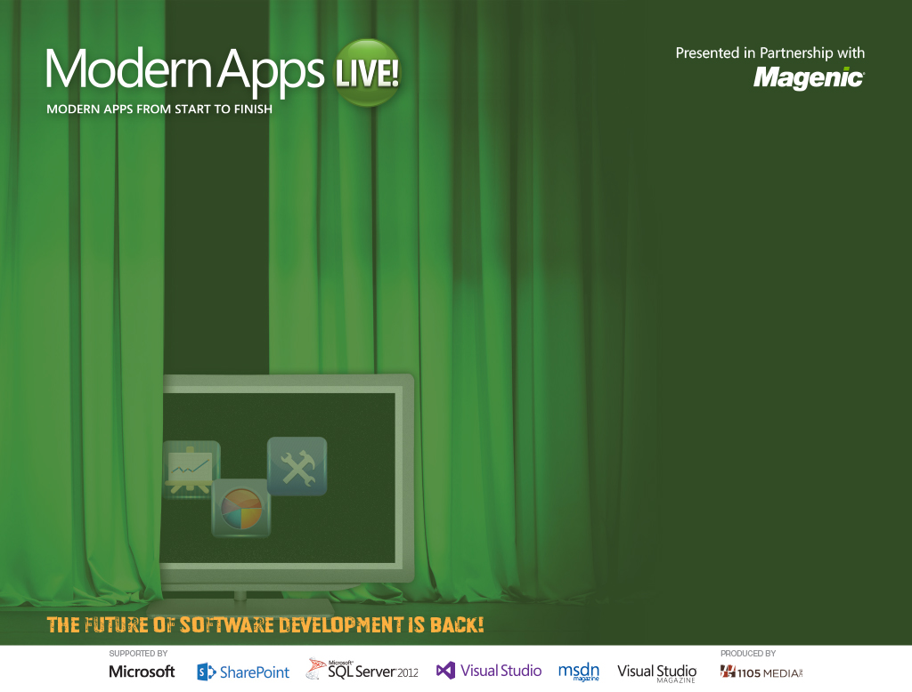
Modern App Architecture
Rockford Lhotka
CTO at Magenic
Level: Intermediate

Slide 2
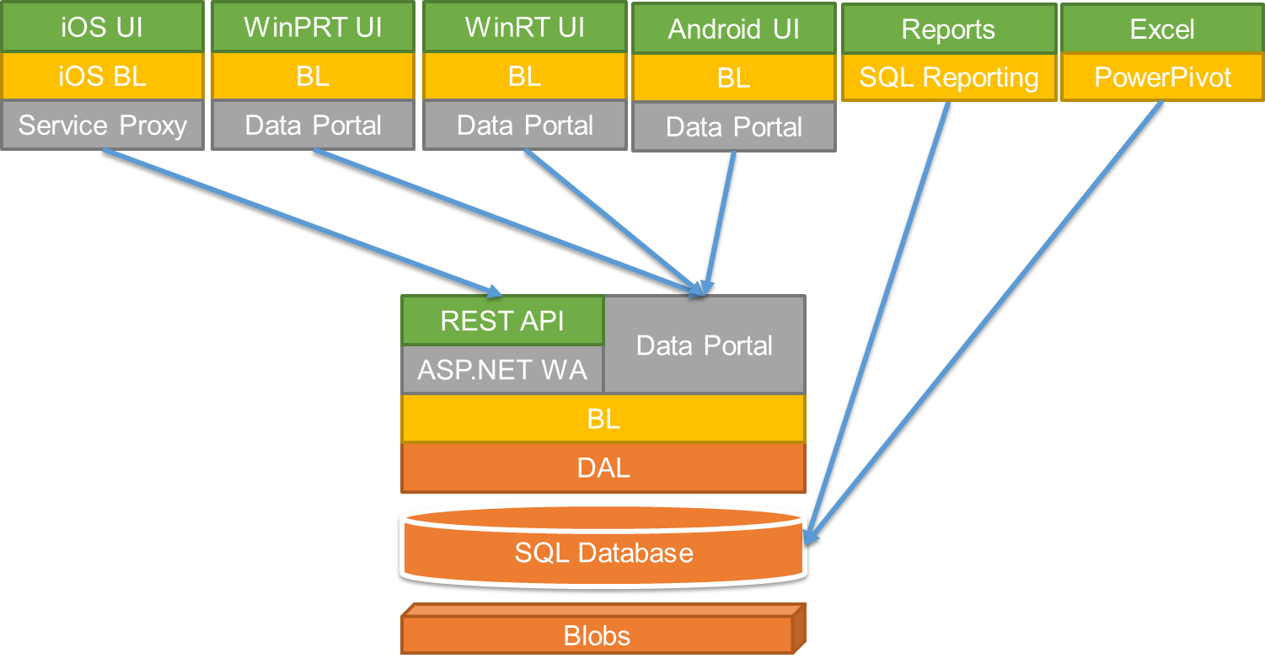
MyVote Architecture
Notes:
This is the MyVote architecture as it stands today.
We’re going to look at how we got to this point.

Slide 3




MyVote App Architecture
HTML 5 UI
iOS UI
WinPhone UI
WinRT UI
Android UI
JavaScript BL
BL
BL
BL
BL
Service Proxy
Data Portal
Data Portal
Data Portal
Data Portal
Reports
SQL Reporting
REST API
Data Portal
ASP.NET WA
BL
Excel
DAL
PowerPivot
SQL Database
Blobs

Slide 4
MyVote Client Platforms
Windows 8.1
Windows Phone 8.1
iPad
Android
Web
Notes:
Windows 8.1 and Windows Phone – me
iPad – Lou Miranda
Android – Xamarin – Nick Landry
Web – Aidan Ryan

Slide 5
MyVote Server Technologies
ASP.NET MVC
Azure
SQL Server
CSLA
Notes:
ASP.NET MVC4 drives the REST API and the Web client.
CSLA is the business object framework we use for the business logic.
Azure for web hosting as well as blob storage
SQL Server 2012 for the database

Slide 6
Putting it together
Notes:
That’s a lot of technologies that need to be brought together.

Slide 7
MyVote Development Goals
Efficient use of distributed team
Each member focuses on strengths
Well designed architecture
Works across many platforms
Maintainability
Minimize duplication of code
Maximize re-use of code
Notes:
Let each member do what they do best, working together as needed at handoff points.
Architecture that plays well with all the kids on the playground.

Slide 8
The foundation
Notes:
Every architecture begins with a solid foundation

Slide 9
Layered Architecture
Organize your…
Application code
Test plans and execution
Development team
Manage complexity
Related functions go in a layer
Layers are isolated
Layers communicate
Notes:
Dev Team – Designers, Design Implementers, UI Developers, Business Object Developers, DBAs
Layers are isolated – They do their own thing without being coupled to other layers.
Layers communicate – They talk to other layers to pass data around, usually through interfaces.

Slide 10
Logical Layers
Breaks application into logical layers
Layers may all run on machine
Layers may run on separate machines
Provides
Maintainability
Readability
Flexibility
Reuse
Lower development/maintenance costs
Notes:
Maintainability – Easier to make changes without having to touch everything
Readability – Clear responsibilities makes it easier to read and understand
Flexibility – Makes it easier to change an entire layer without affecting the other layers. Data access, for example
Reuse – When multiple platforms are involved, it’s easier to reuse code that is structured in logical layers

Slide 11
Anatomy of a Modern App
Presentation
Presentation Logic
Business Logic
Data
Data Access
Notes:
Most business apps need some sort of data. This data can be in a database or somewhere on the web.
Most business apps also have business rules that govern that data.
Most apps need some sort of UI. This is how the data will be presented to the user.
A well designed architecture should be testable. Having the business layer talking directly to the data layer would make testing very difficult, if not impossible. It really should have a data access layer.
To make as much of the app testable as possible, presentation logic should be separated from the presentation.

Slide 12
N-Layer
Presentation
Presentation Logic
Business Logic
Data Access
Data
Notes:
N-Layer architectures should begin with these building blocks.

Slide 13
Multiple Data Sources
Interface
Interface Control
Business Logic
Data Access
Data Access
Data Access
Data Access
Data Access
Data Access
Data
SQL
Oracle
DB2
XML
WCF
Notes:
A well designed architecture will keep the impact of different data layers to a minimum.
“Program to the interface, not the implementation”

Slide 14
Multiple Presentations
Windows
Presentation
XML
Mobile
Web
WCF
Presentation Logic
UI
UI
UI
UI
UI
Business Logic
Data Access
Data Access
Data Access
Data Access
Data Access
SQL
Oracle
DB2
XML
WCF
Notes:
A well designed architecture should keep the impact of different presentations to a minimum.

Slide 15
Physical Tiers
Deploy logical layers to physical tiers
Trade off between
Performance
Scalability
Fault tolerance
Security
Notes:
Physical tiers can be the client’s machine, phone, or tablet. Or web or database servers.
How you structure your physical tiers brings trade offs.

Slide 16
N-Layer App Architecture
Interface
Interface Logic
Business Logic
Data Access
Data
Notes:
N-Layer architectures should begin with these building blocks.

Slide 17
2-Tier App Architecture
Interface
Interface Logic
Business Logic
Data Access
Data
Notes:
N-Layer architectures should begin with these building blocks.

Slide 18
3-Tier App Architecture (client logic)
Interface
Interface Logic
Business Logic
Data Access
Data
Notes:
N-Layer architectures should begin with these building blocks.

Slide 19
3-Tier App Architecture (server logic)
Interface
Interface Logic
Business Logic
Data Access
Data
Notes:
N-Layer architectures should begin with these building blocks.

Slide 20
3-Tier App Architecture (shared logic)
Interface
Interface Logic
Business Logic
Business Logic
Data Access
Data
Notes:
N-Layer architectures should begin with these building blocks.

Slide 21
Edge App Architecture
Interface
Interface Logic
Business Logic
Data Access (svc proxy)
Service
Notes:
N-Layer architectures should begin with these building blocks.

Slide 22
Service Architecture
Caller
Interface
Interface Logic
Business Logic
Data Access
Data
Notes:
N-Layer architectures should begin with these building blocks.

Slide 23
Disconnected Edge App Architecture
Interface
Interface Logic
Business Logic
Data Access
Data (client)
Sync
Data (server)
Notes:
N-Layer architectures should begin with these building blocks.

Slide 24
Windows, iOS, Android Apps
XAML
C# Controllers/ViewModels
C# Business Logic
C# Business Logic
Entity Framework
SQL Server
Notes:
N-Layer architectures should begin with these building blocks.

Slide 25
HTML 5 App
Client
HTML/CSS
JavaScript Controllers/ViewModels
JSON Model
Server
AJAX
JSON
Web API Controller
C# Business Logic
Entity Framework
SQL Server
Notes:
N-Layer architectures should begin with these building blocks.

Slide 26
what does it all mean?

Slide 27
The Multi-Platform Conundrum
Code re-use is ideal
But only an option for .NET platforms
What about the rest?
Must duplicate effort

Slide 28
Combat Code Duplication
Maintain all code for all platforms?
Generate platform-specific code based on C# code?
How?
Complete code generation?
How?
Some sort of meta language?
What tool do you use?
Use Mono/Xamarin?
Notes:
These are some questions each team must answer somehow

Slide 29
Can you afford multiple dev teams?
If so…
Which platforms do you target?
How many should you target?
If not…
Do you choose some platforms?
Which ones?
Do you choose a cross-platform solution?
Which one?

Slide 30
What about versioning?

Slide 31
Versioning
With new versions come additional maintenance
Client and Server can get out of sync
Likely leads to maintaining multiple versions
Notes:
Need to plan for how to maintain versions when the client doesn’t update right away.
Apps on multiple platforms may not deploy at the same time.
Web can update immediately
Native apps rely on the user updating them (which may or may not be automatic)

Slide 32
Versioning Options
Maintain different REST API Urls
As clients update, they get the new urls
Double (or more!) maintenance
Might be ok for short-term situations (days/weeks)
Long-term nightmare
Make Smart Service
Parse doc and determine version
More work, but not multiple maintenance
Can be used for months or years

Slide 33
What’s the right answer?

Slide 34
42
Notes:
The right answers depend heavily on your team and organization.

Slide 35
Architecture is hard!
Source: http://blu.stb.s-msn.com/i/FE/A31AA556A3AD65F85FBA513BD4AA5.gif
Notes:
Architecture involves tough choices

Slide 36
Parting Thoughts
Leverage Layered Architecture
Spread layers across tiers
Be prepared for logic duplication
Remember to KISS
Keep It Simple

Slide 37
Questions?

